Slide 1

Rising incidence of diabetes in united states

Slide 2




team
Rayon King
Dominic Familette
Makenzie Eason
Jessica Guinn

Slide 3


Agenda
Race
Age
Gender
Diagnosed Data
Trends and Correlations
Death Rate
Summary
Conclusion

Slide 4



Introduction
Our research delves into the intricate landscape of diabetes and its associated mortality rates. Drawing insights from data compiled by the Centers for Disease Control and Prevention. With a focus on demographics statistics, we aim to establish correlations and uncover potential patterns to understand the impact of this growing health concern. Through our analysis of the provided data, we aim to contribute valuable insights into the complexity of diabetes-related deaths, and associated risk factors that may impact your chances of diabetes diagnosis.

Slide 5
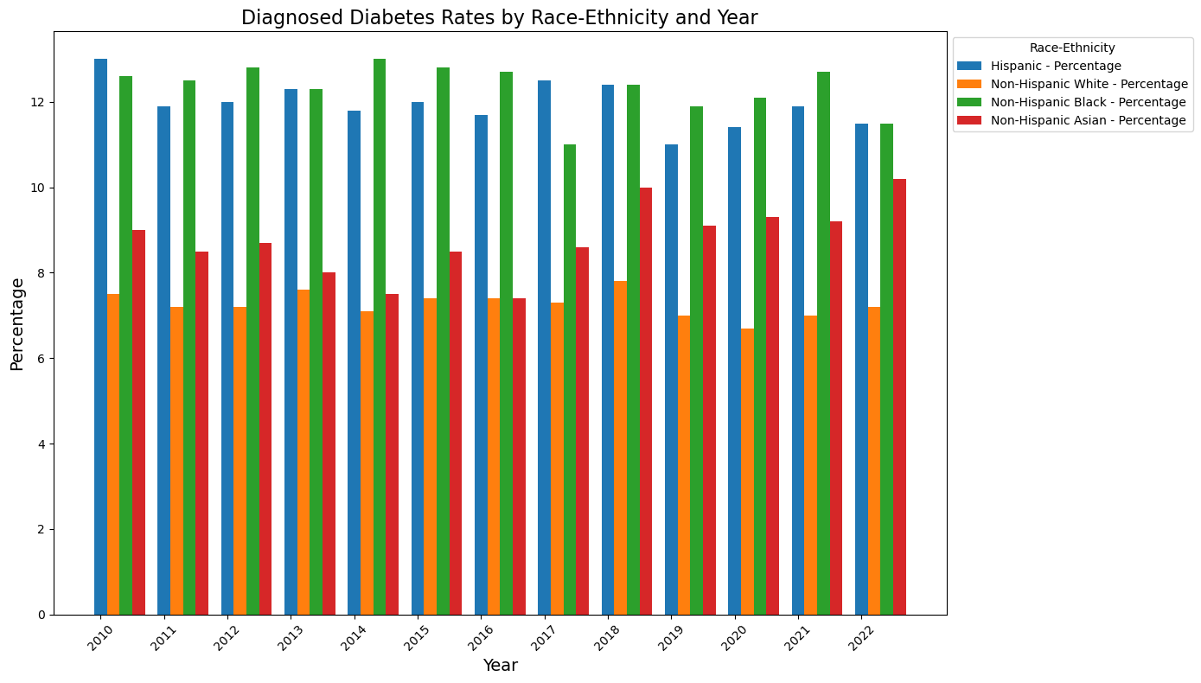
race
Diabetes rates have been relatively stable for Hispanic, White, and Black communities.
Asian populations have seen the most significant increase in diabetes rates.
Black and Hispanic communities have had the highest incidence of diabetes since 2008.
Without causal information, it's hard to pinpoint the cause of these differences.

Slide 6
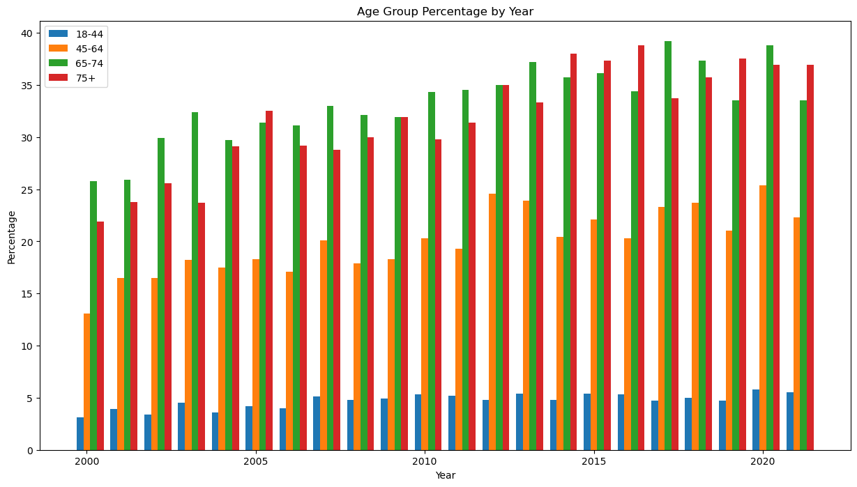
Age group by year analysis
All age groups have experienced a steady rise in rates.
The 18-44 y.o. group had a sizeable increase over the years, nearly doubling over between 2000 and 2021.
The 45-64, 65-74 and 75+ y.o. groups have also experienced a consistent rise over the last 20 years.

Slide 7
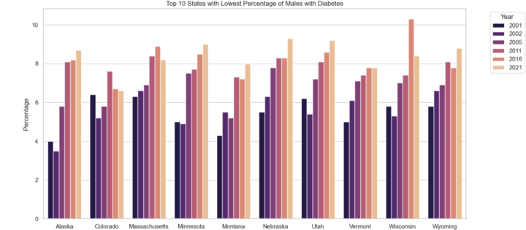
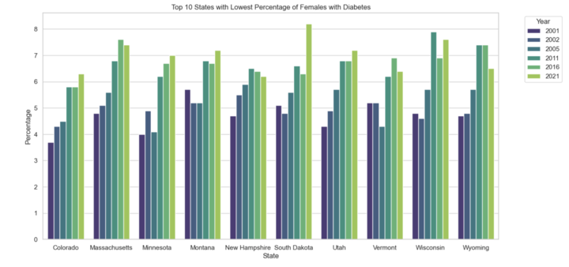
10 States with the Lowest Percentage of Males and Females with Diabetes
Colorado Massachusetts Minnesota Montana Utah Vermont Wisconsin Wyoming
Female Only
New Hampshire South Dakota
Male Only
Alaska Nebraska
State Correlations

Slide 8
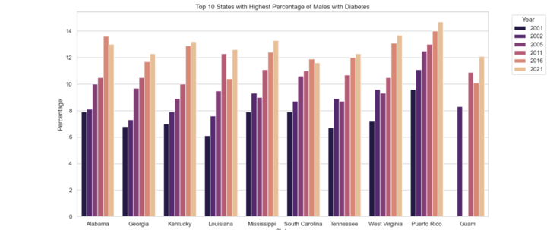
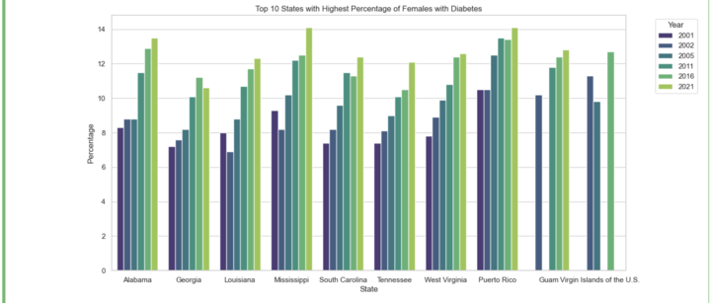
10 States with the Highest Percentage of Males and Females with Diabetes
Alabama
Georgia
Louisiana
Mississippi
South Carolina Tennessee
West Virginia
Puerto Rico
Guam
Female Only
Virgin Islands
Male Only
Kentucky
State Correlations

Slide 9
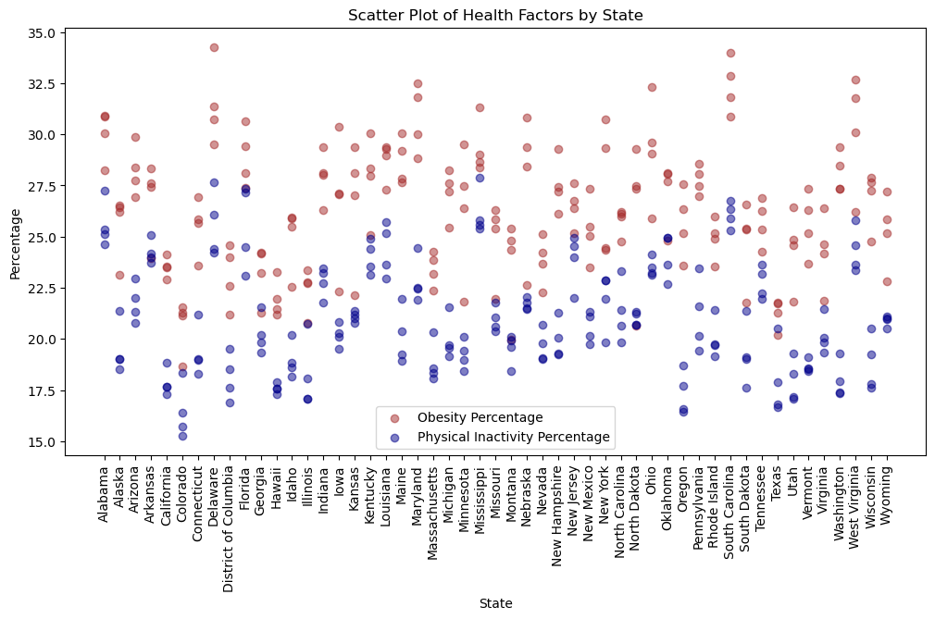
diagnosis Analysis
This dataset contains information on state diagnosis, obesity rate, and physical inactivity rates.
Obesity and physical activity often correlate, as the obesity rate increased as the physical activity trend decreased.
It is important to note that although obesity and physical activity correlate, they are not the same thing. Generally, states with a lower activity rate had a higher rate of obesity.
A further analysis would be necessary for definitive conclusions on the differences and correlations of the two datasets.

Slide 10
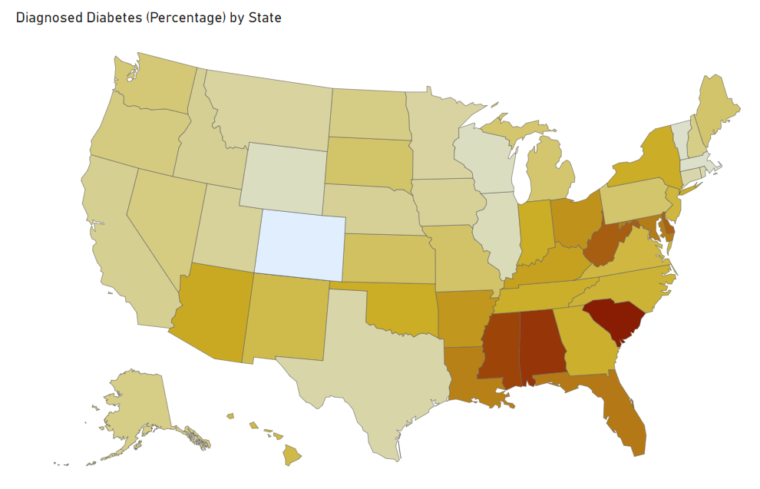
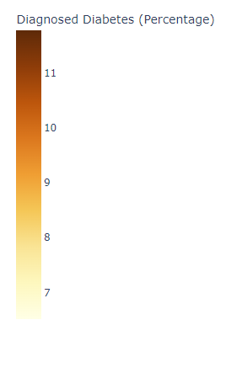
Center of Disease Control 2018 Diabetes Diagnosis (Percentage) by State

Slide 11
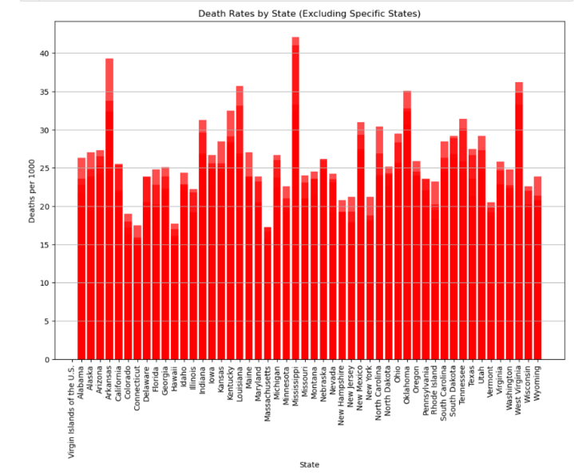
Death rates
This chart shows the affect diabetes has on mortality rates in America from 2012 to 2021.
As shown Mississippi, Arkansas, and West Virginia are the top three states with the highest death rate percentages..
We were expecting to show some separation between southern and northern states. However, the data shows somewhat even ranges between states.

Slide 12

Trends and Correlations
The Asian-American communities have seen the most substantial rise in diabetes rates.
Black and Hispanic communities have higher rates than others.
Diabetes rates increase with age, though the younger population had the highest increase proportionately.
Men have consistently higher rates (roughly 1% higher) than women.
There is a positive correlation between physical inactivity and diabetes rates.

Slide 13
Conclusion
Limitations
Complete years of data to combine datasets. Difficulty in comparing multiple demographics by state and years.
Limited information on dietary impacts for diabetes diagnosis.
Time constraints for finding and compiling datasets, datasets initially found did not benefit the analysis processes due to a change in direction.
Lessons Learned
Regardless of the cause, diabetes is on the rise in the United States.
Finding better datasets to support additional analysis on nutrition, further demographics i.e., income, population etc.
The ability to have more time to engage in team project work, this could have resulted in a more in-depth scope of work.
More experience in working through GitHub and shared environments Git Push/Pull. Practicing in GitHub for constant changing environment and working within a team.

Slide 14




References
https://gis.cdc.gov/grasp/diabetes/diabetesatlas.html
https://www.cdc.gov/diabetes/data/statistics-report/index.html
https://www.cdc.gov/nchs/pressroom/sosmap/diabetes_mortality/diabetes.htm
https://www.tvguide.com/tvshows/scrubs/cast/1030250284/
https://www.reddit.com/r/oddlyterrifying/comments/vsg62e/dystopian_world_ruled_by_mcdonalds/
https://moviemansguide.com/main/2017/02/review-doctorstrange-3dbd/
https://www.digitalspy.com/tv/ustv/a830910/house-cast-where-are-they-now/

